Slide 1
The ‘Three Kills Protocol’ (3KP)
March 21, 2014

Slide 2
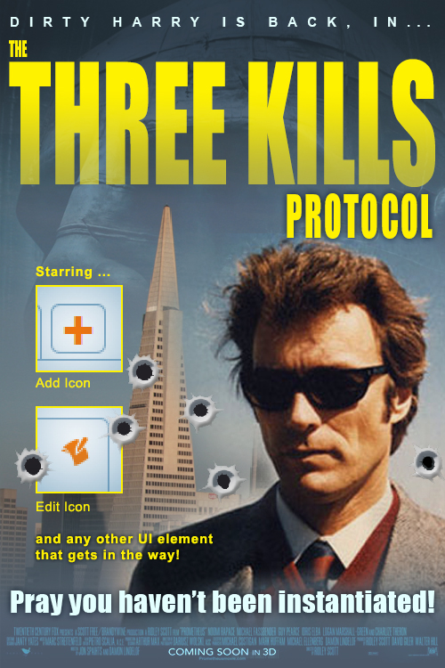
‘The Three Kills Protocol’
3KP for short
It is an invisible front-end Mechanism that will be repeatedly and frequently invoked in the CRM and throughout the new, redesigned LeaseStar
Needed for edge cases
Enhances User Experience
But also needed to prevent conflicts and crashes
Designed to keep Users on the ‘Happy Path’ when they’ve initiated a process that modifies the record.

Slide 3
Why 3KP is needed
The Good, the Bad and the Ugly

Slide 4
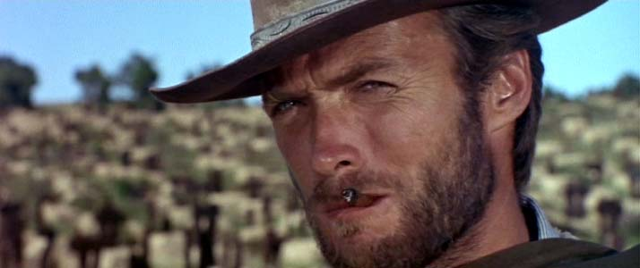
Why 3KP is needed – the Good

Slide 5
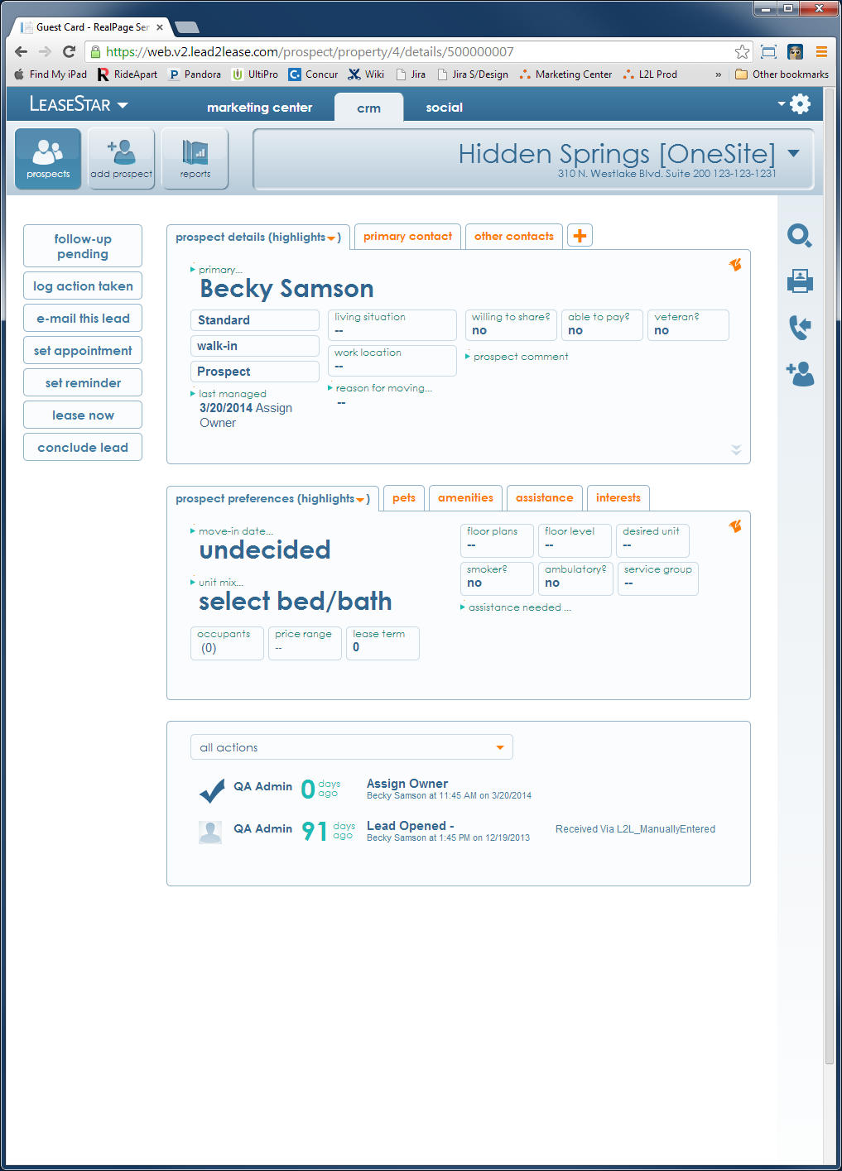

Why 3KP is needed – the Good
The new LeaseStar UX was designed to facilitate access to key information relevant to the context, even when the User is in the middle of doing something unrelated
User

Slide 6
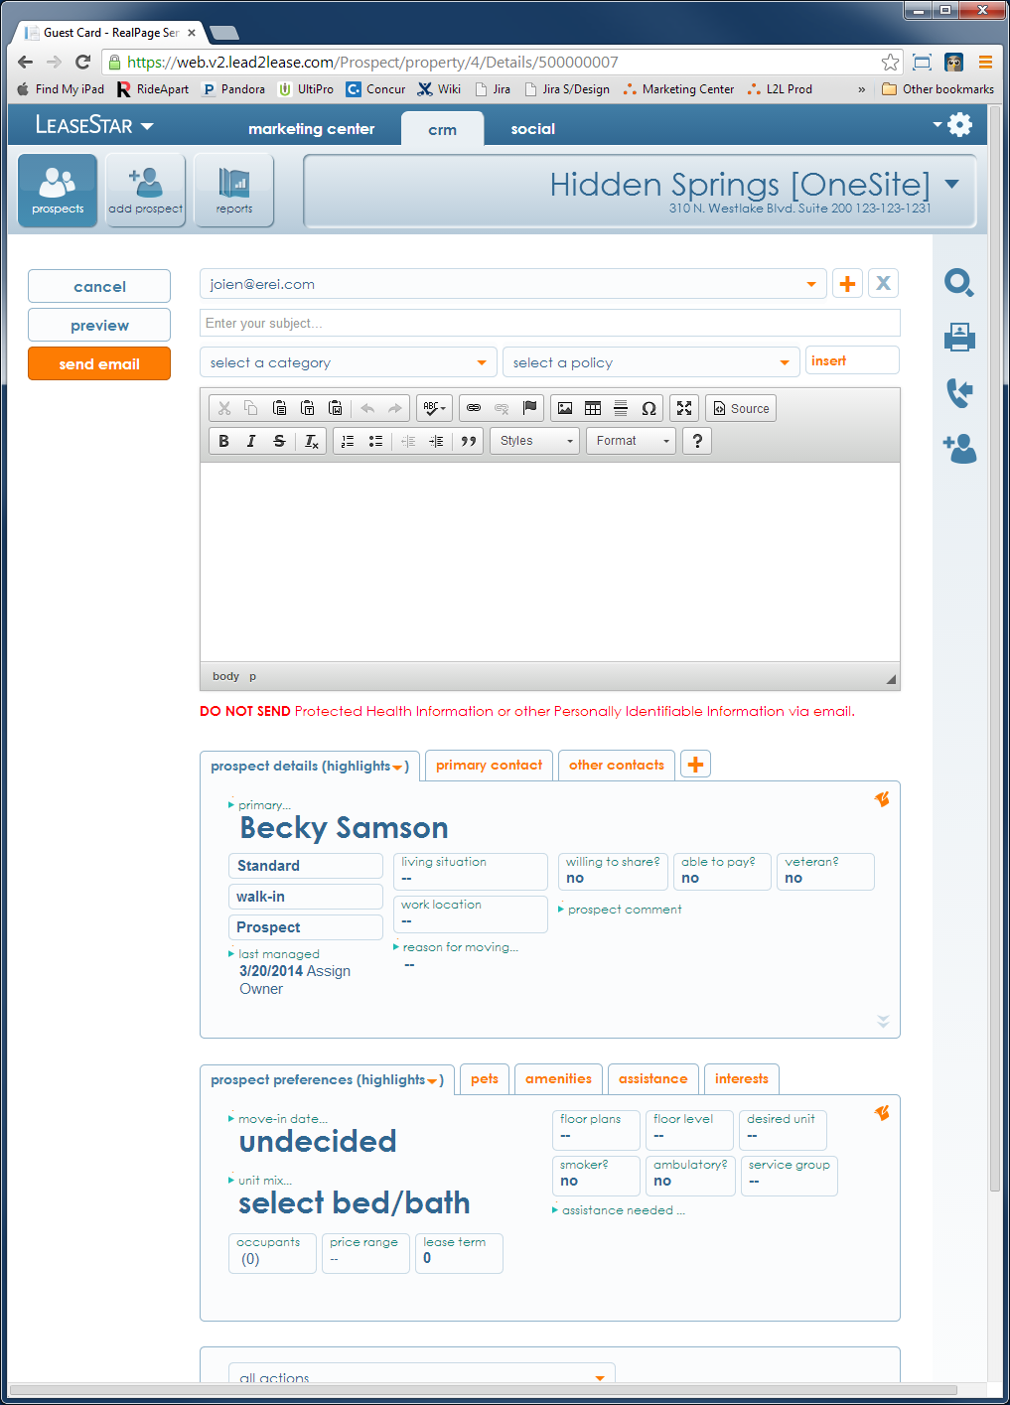

Why 3KP is needed – the Good
For example:
Let’s say the User wishes to e-mail the Prospect
User

Slide 7

Why 3KP is needed – the Good
But in the course of writing it, can’t remember if the Prospect was a swimmer or not …
User

Slide 8
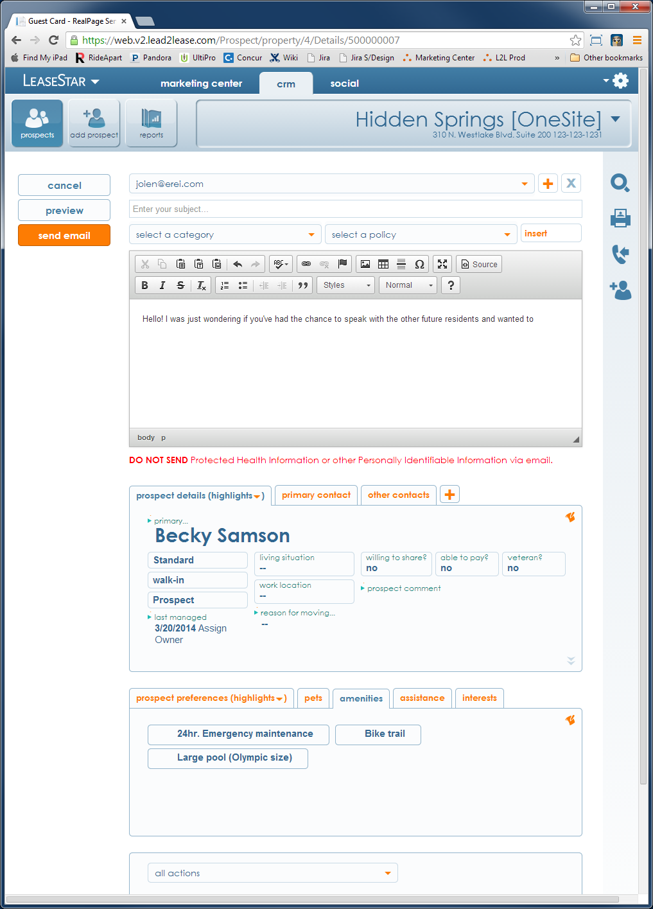

Why 3KP is needed – the Good
But in the course of writing it, can’t remember if the Prospect was a swimmer or not
So she flips over to the Amenities tab in Prospect preferences …
and notices that ‘Large Pool’ was among the requested amenities
User

Slide 9
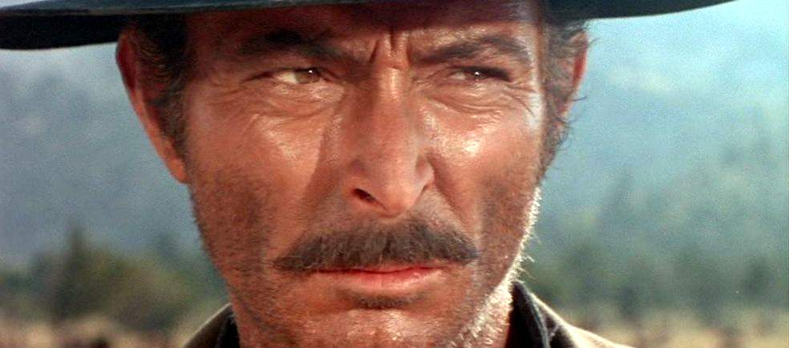
Why 3KP is needed – the Bad

Slide 10
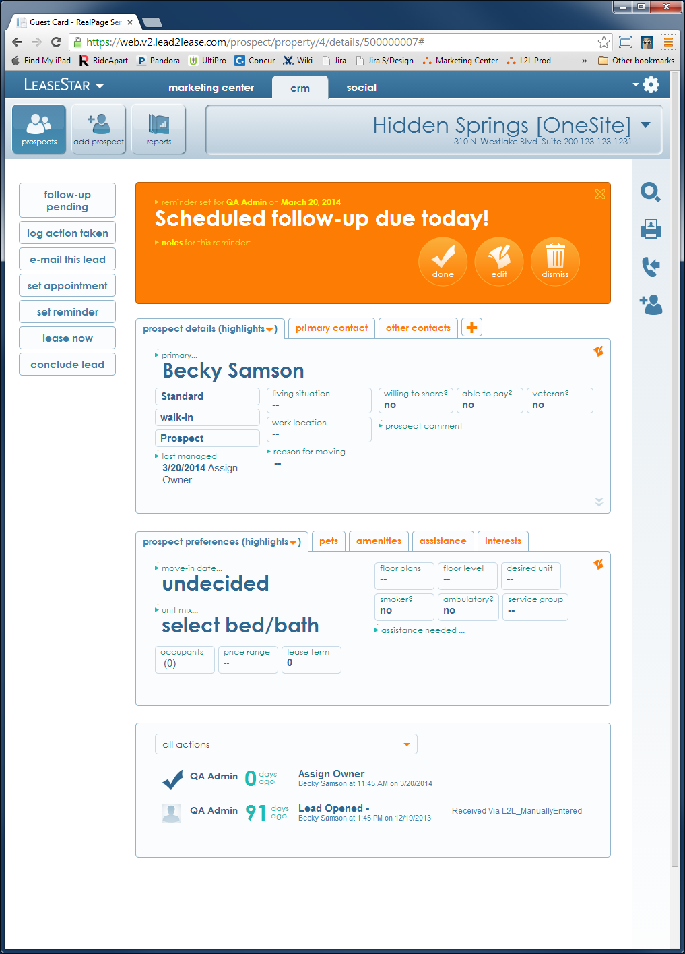
Why 3KP is needed – the Bad
onLoad of a typical Prospect
With a follow-up scheduled for today
User

Slide 11
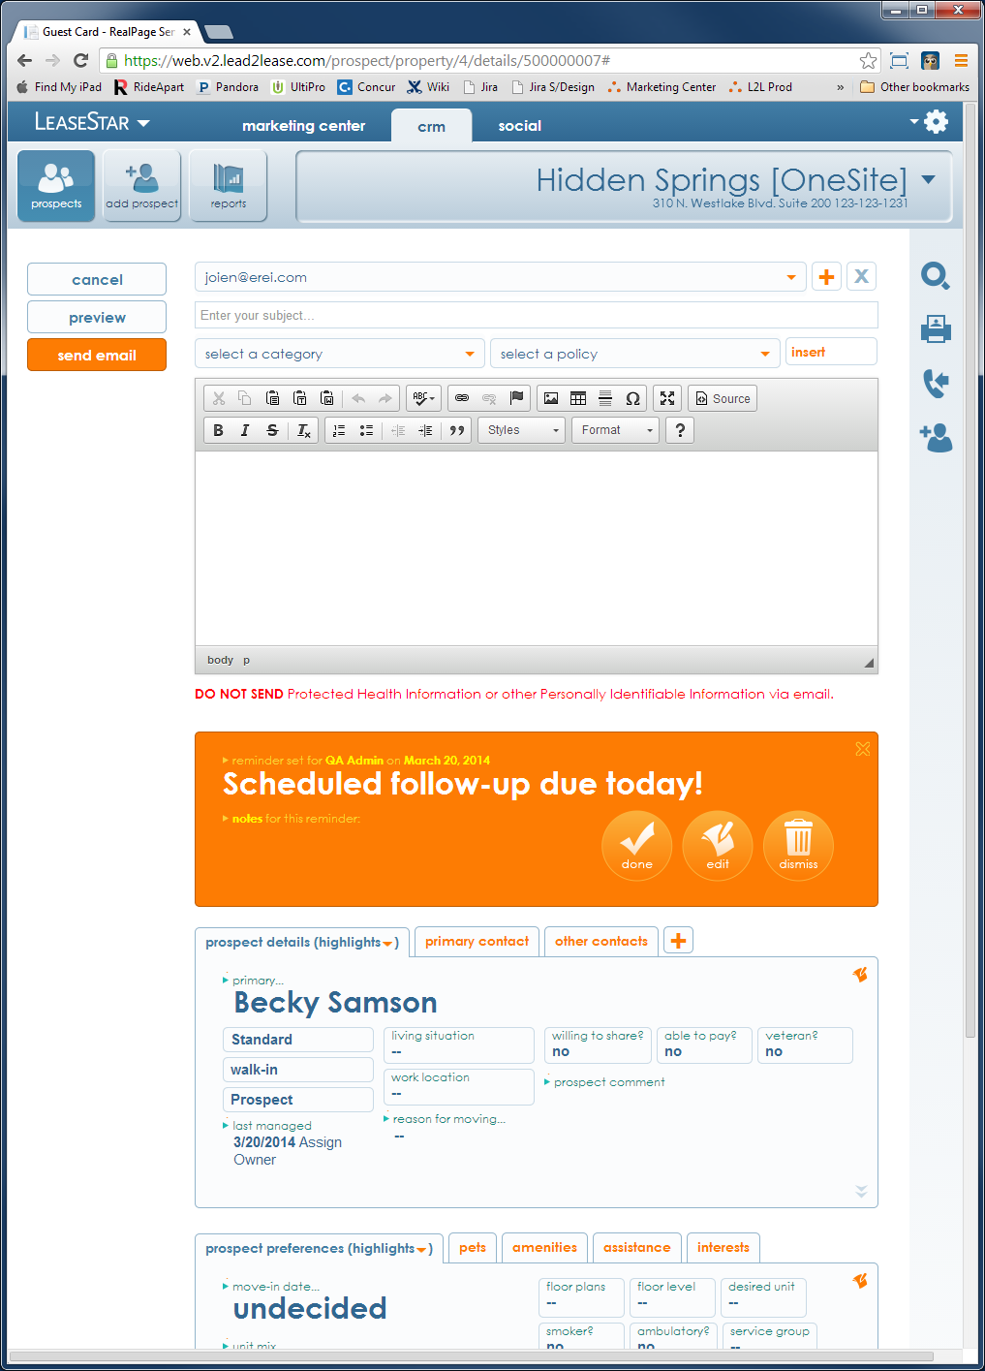
Why 3KP is needed – the Bad
User decides to follow up by e-mail
So she clicks ‘e-mail this lead.’
User

Slide 12
Why 3KP is needed – the Bad
She’s somewhat annoyed that the follow-up reminder is still in her face because she’s following up now …
Valuable vertical real estate is being wasted
User

Slide 13

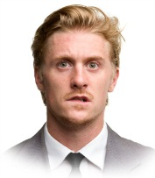
Why 3KP is needed – the Bad
She then realizes the last person she spoke to about the Prospect she’s e-mailing said HE should be regarded as the Primary Contact
She remembers this because his e-mail address isn’t available in the dropdown
User

Slide 14
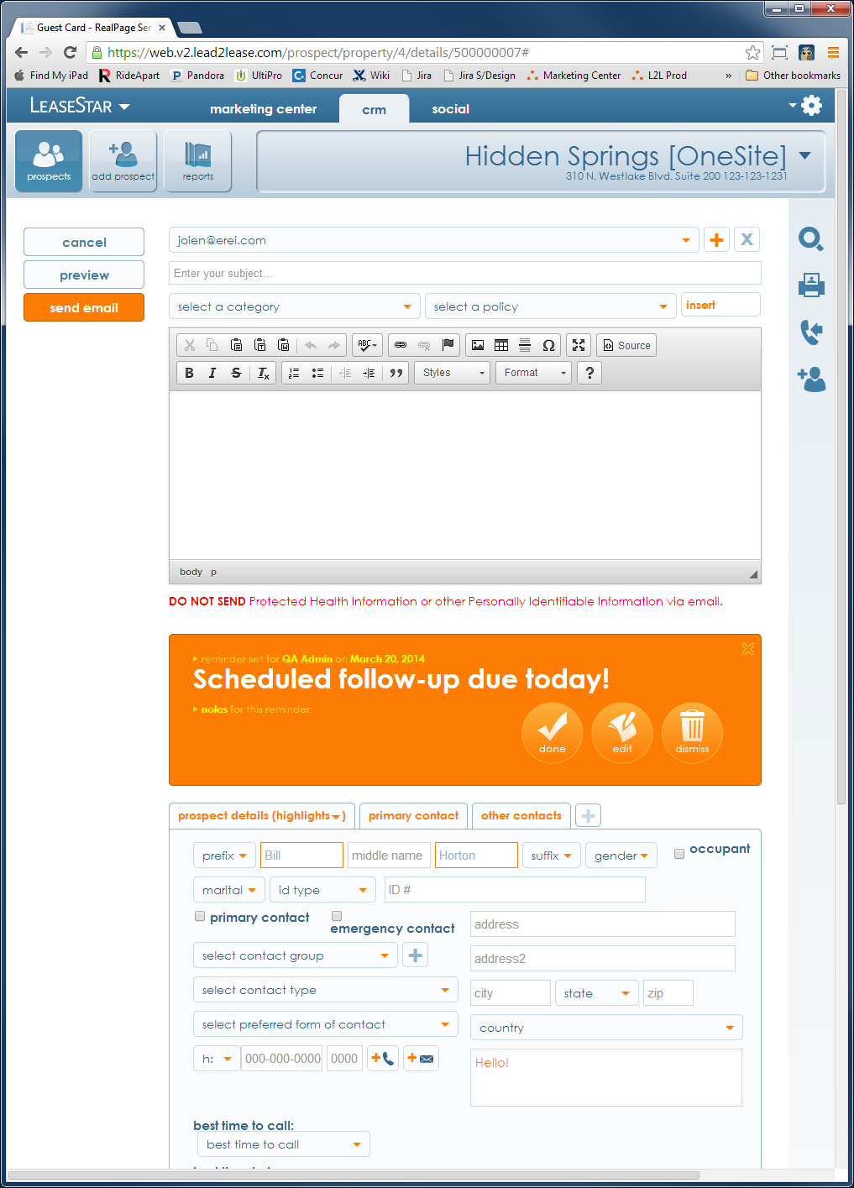

Why 3KP is needed – the Bad
So she quickly adds a new Contact …
… and enters his name and e-mail address …
User

Slide 15

Why 3KP is needed – the Bad
And then goes to save this change …
... except there is no Save button.
Because she was in the middle of sending an e-mail when she shifted gears
And e-mails don’t need to be saved – just Sent
User

Slide 16
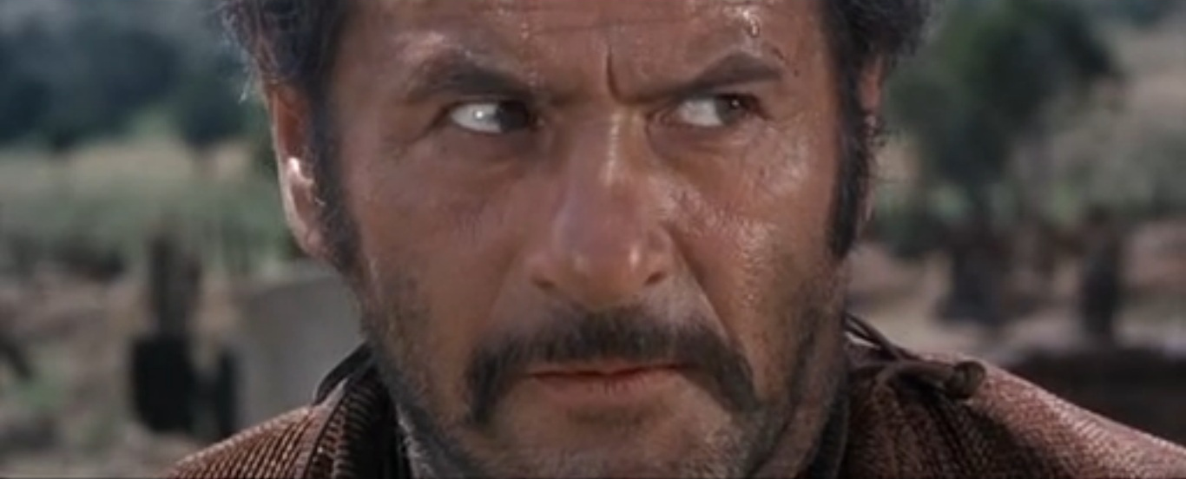
Why 3KP is needed – the Ugly

Slide 17

Why 3KP is needed – the Ugly
Right after she notices there’s no Save button, she realizes the new Contact gave her a move-in date she vitally needed to convert this Prospect …
June 1st
User

Slide 18
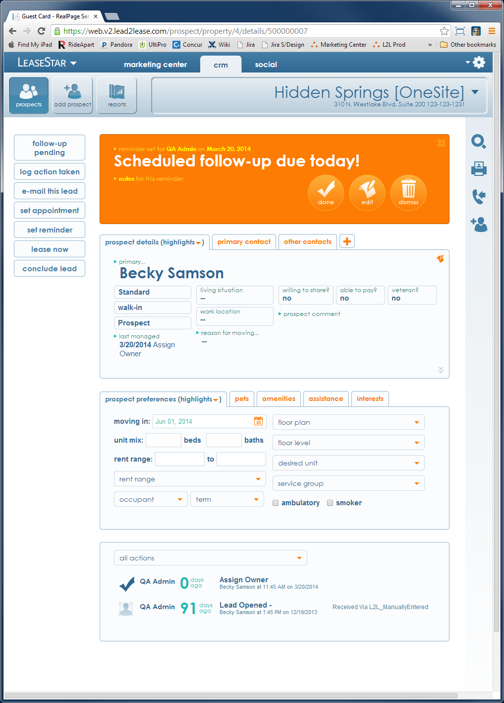

Why 3KP is needed – the Ugly
So before she forgets it, she flips the Prospect Preferences tab in to EDIT MODE
And enters that move-in date.
User

Slide 19
Why 3KP is needed – the Ugly
Once the date is entered, she goes to save it
But now, again, there is no Save button available
Indeed, not even a ‘Cancel’ button is available
Not to mention the fact that the E-mail box has inexplicably vanished
???
User

Slide 20

Why 3KP is needed – the Ugly
The User is now utterly flummoxed
How can she be in EDIT MODE and have no Save/Cancel buttons available?
Our User is caught in a usability dead zone from which she cannot escape without dumping out of this screen entirely
User

Slide 21
Why 3KP is needed
So the distinction that needs to be made is this:
There is a difference between enabling the User to ACCESS all relevant data in the middle of an unrelated activity
And enabling the User to CHANGE all relevant data in the middle of an unrelated activity

Slide 22

When will the three kills protocol be invoked?
Do you feel lucky, punk?

Slide 23
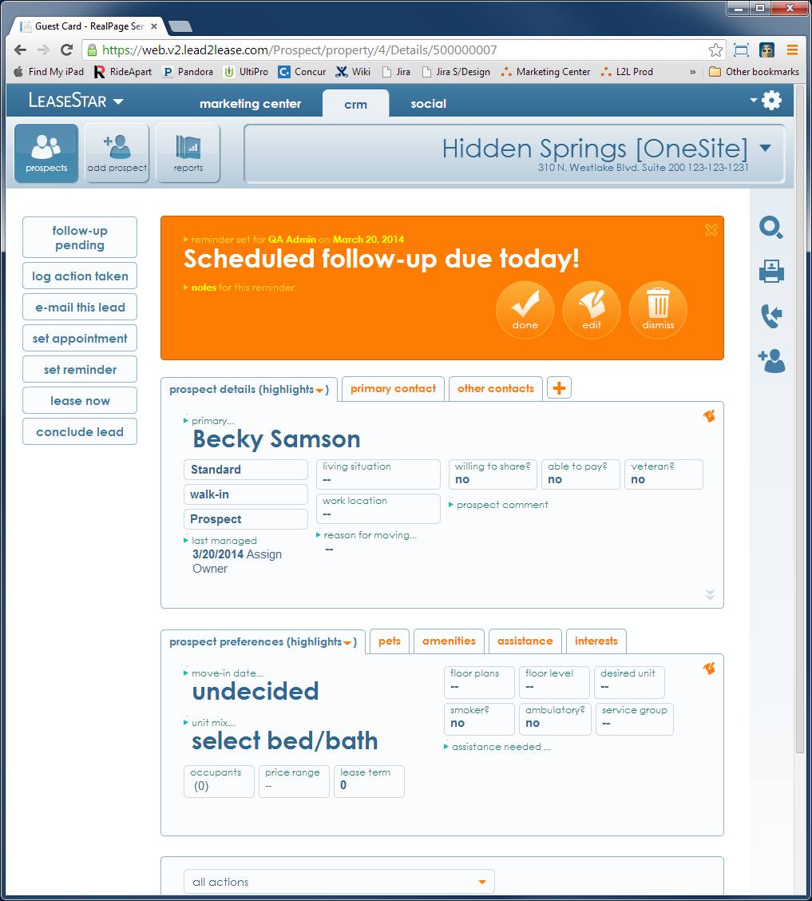
When will the Three Kills Protocol be invoked?
The Three Kills Protocol (3KP) will be invoked whenever the User initiates certain processes we decide require it.
We’ll call these “3KP-Worthy Processes.”

Slide 24
When will the Three Kills Protocol be invoked?
So the sequence will go as follows:
User begins 3KP-Worthy-Process
3KP is invoked
User completes or cancels out of the 3KP-Worthy Process
3KP is revoked

Slide 25
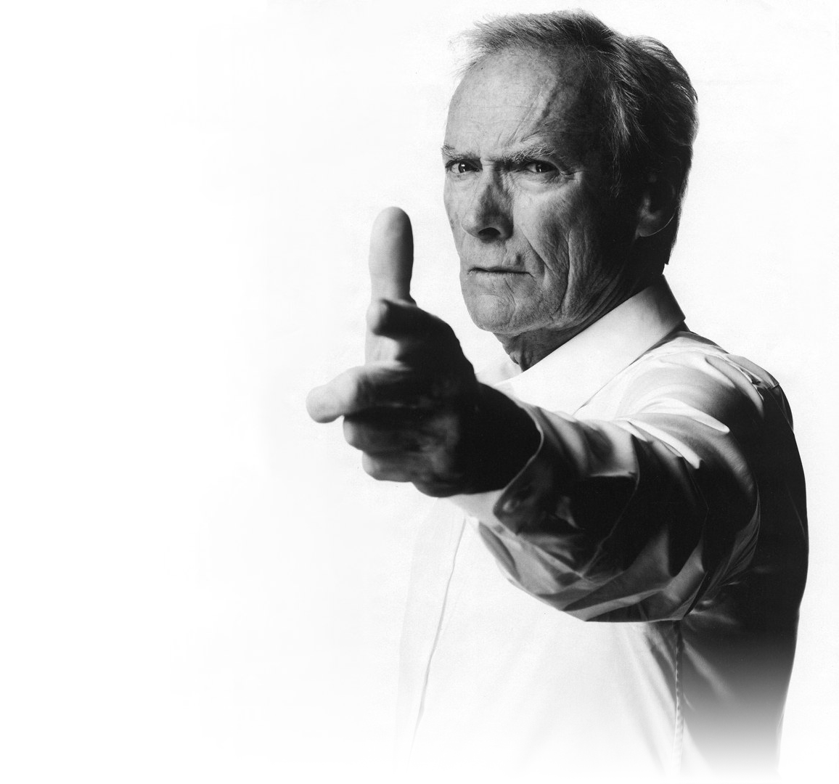
What’s getting killed
The targets …

Slide 26
What’s Getting Killed
These are the targets:

Slide 27
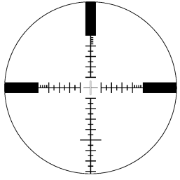
What’s Getting Killed
These are the targets:
Add Buttons unrelated to the 3KP-Worthy Process in progress

Slide 28
What’s Getting Killed
These are the targets:
Add Buttons unrelated to the 3KP-Worthy Process in progress
Edit Buttons unrelated to the 3KP-Worthy Process in progress

Slide 29
What’s Getting Killed
These are the targets:
Add Buttons unrelated to the 3KP-Worthy Process in progress
Edit Buttons unrelated to the 3KP-Worthy Process in progress
Notifications or other UI elements extraneous to the 3KP-worthy process in progress

Slide 30
The Three kills protocol in action
So what will it look like?

Slide 31
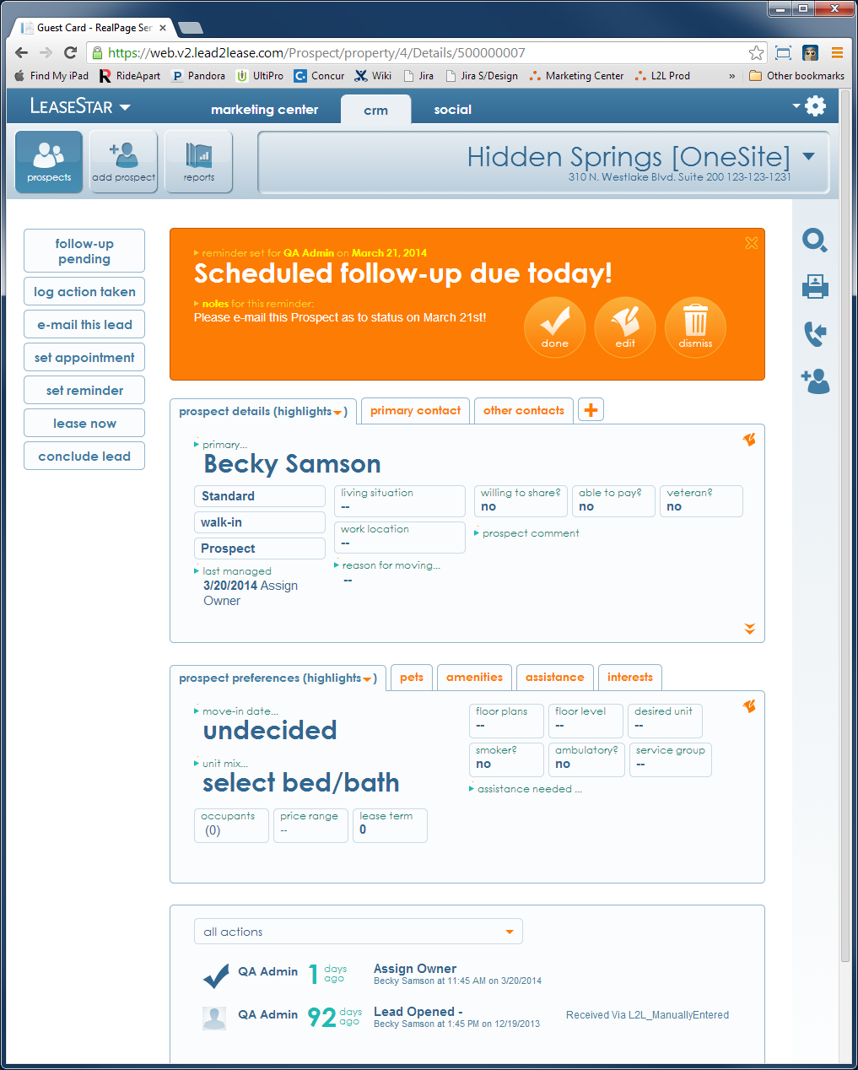
3KP in Action
Let’s use the same example we started with:
onLoad of a typical Prospect
With a follow-up scheduled for today
User

Slide 32
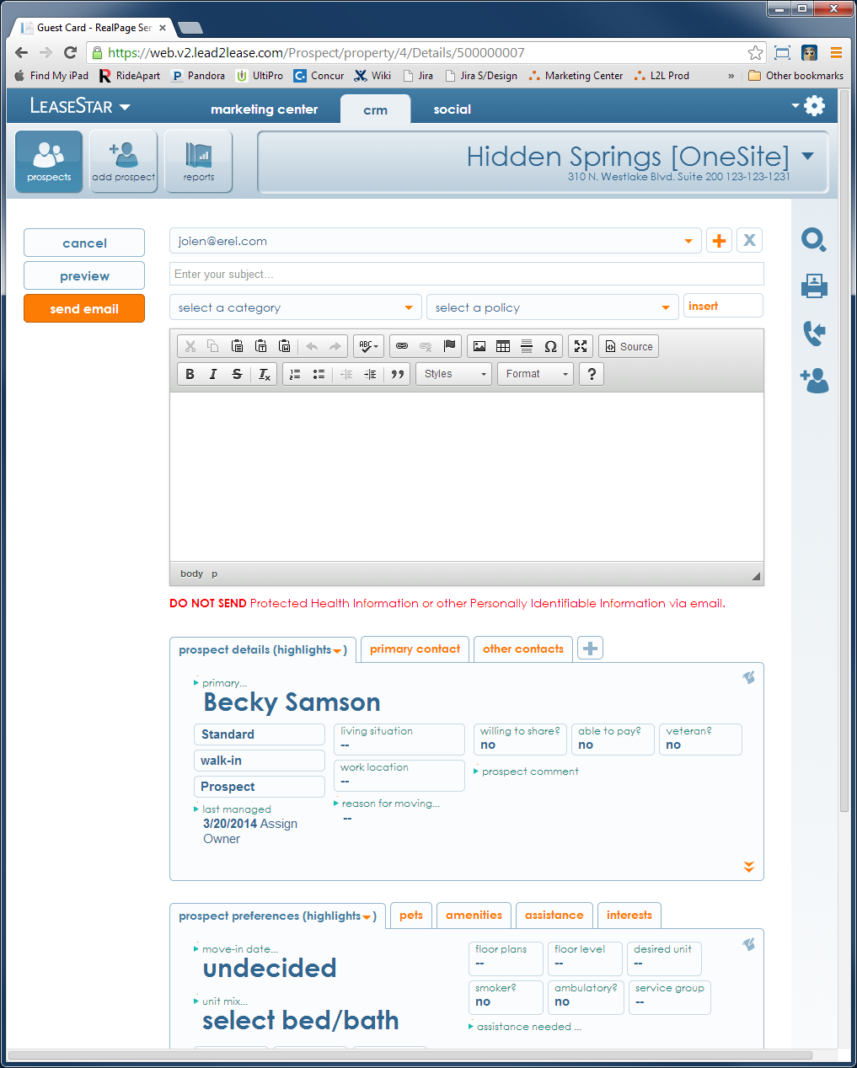
3KP in Action
User decides to follow up by e-mail
So she clicks ‘e-mail this lead.’
User

Slide 33
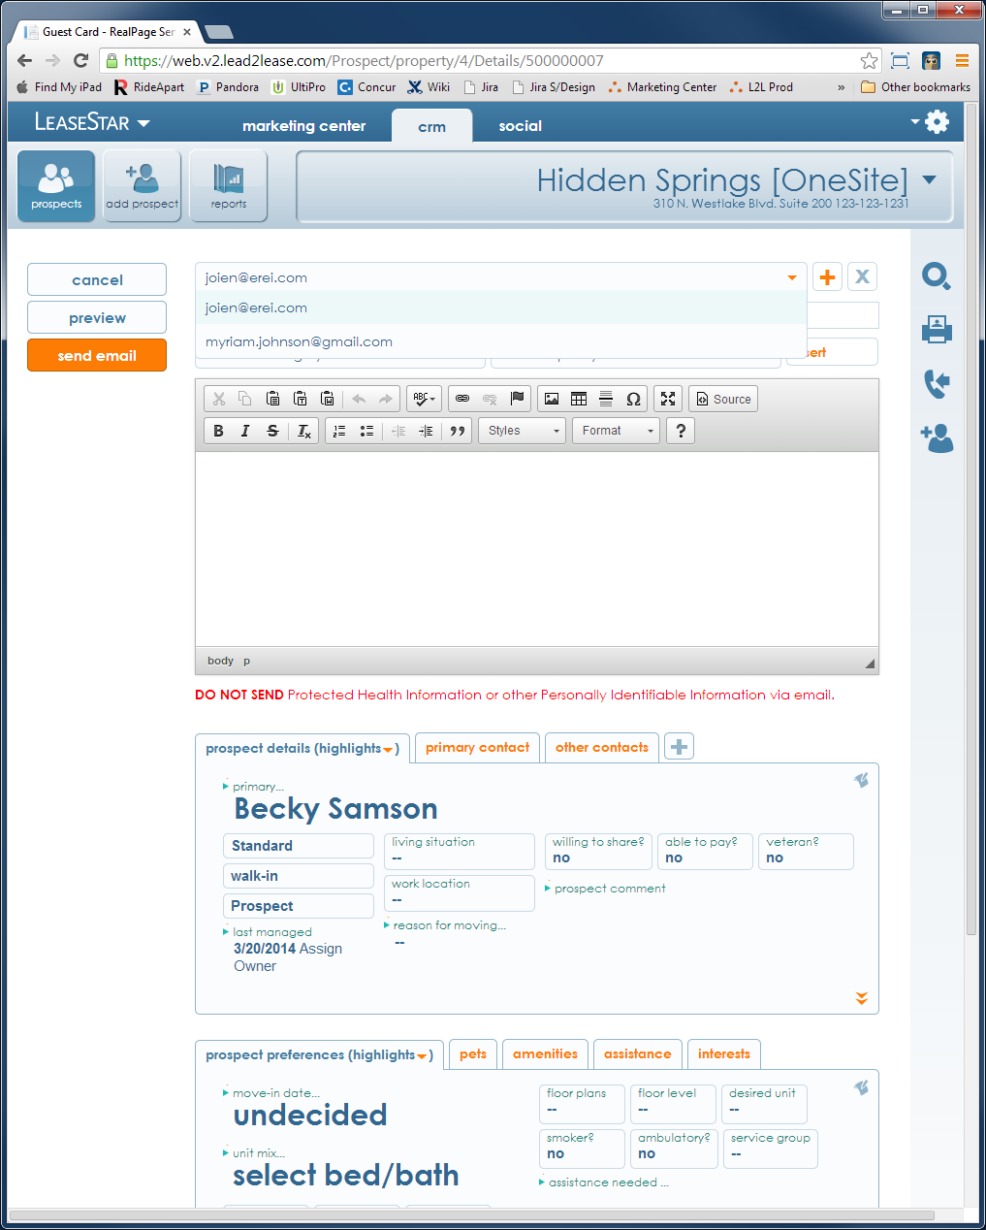

3KP in Action
She then realizes the last person she spoke to about this Prospect said he should be regarded as the Primary Contact
She remembers this because his e-mail address isn’t available in the dropdown
User

Slide 34

3KP in Action
So she goes to add a new Contact
But she notices the Add button is now greyed
User

Slide 35
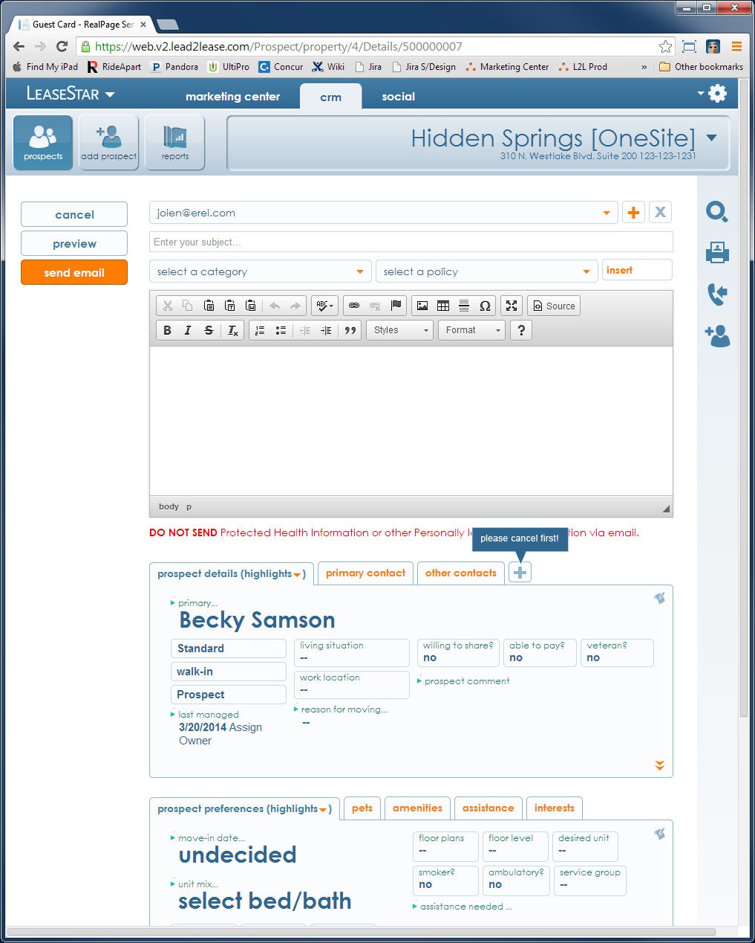
3KP in Action
But she clicks it anyway
And sees a generic tooltip explaining why: “please cancel first”
User

Slide 36
3KP in Action
At that moment, she realizes the new Contact gave her a move-in date she vitally needed to convert this Prospect …
June 1st
User

Slide 37
3KP in Action
So before she forgets it, she goes to flip the Prospect Preferences tab in to EDIT MODE ….
But notices the Edit button is greyed
User

Slide 38
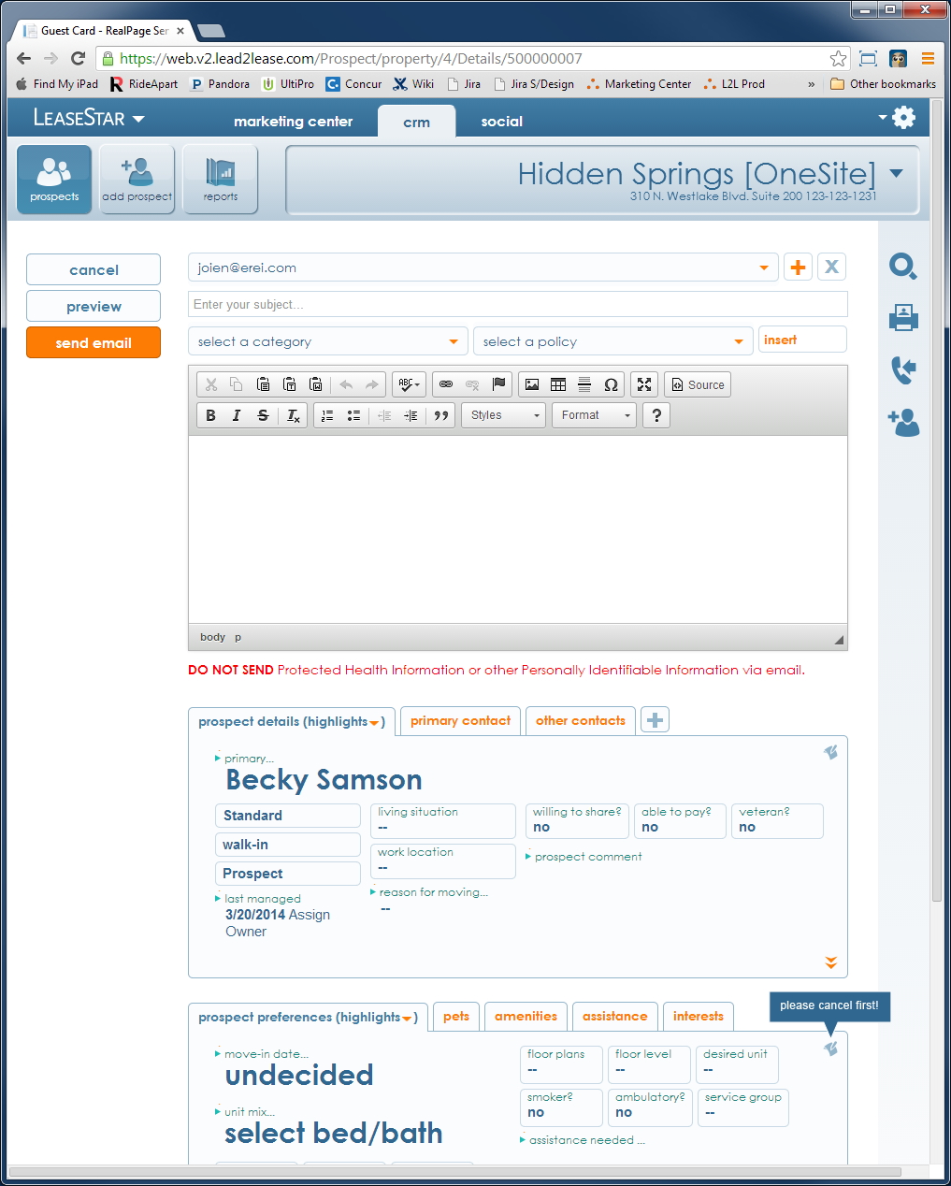
3KP in Action
But, again, she clicks it anyway
And sees a generic tooltip explaining why: “please cancel first”
User

Slide 39

3KP in Action
This is a trend, she realizes. She now understands that because she’s in the middle of sending an e-mail, there’s certain things she cannot do. If she cancels out of the current process, as the tooltips suggest, perhaps she can Add and Edit this record again.
User

Slide 40
3KP in Action
So, she cancels out of the
e-mail flow …
User

Slide 41
3KP in Action
And notices the options to Add and Edit the record have returned
Along with the follow-up notification
User

Slide 42
3KP in Action
And notices the options to Add and Edit the record have returned
Along with the follow-up notification
Yay!
User

Slide 43
How will I know when to invoke 3KP?
Yeah, but …

Slide 44
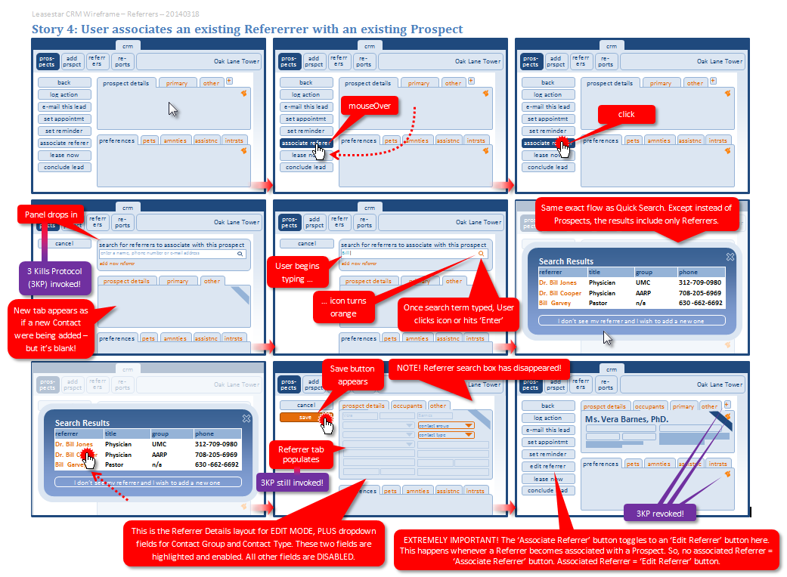
How will I know when to invoke 3KP?
3KP-Worthy Processes will be called out in all subsequent wireframes

Slide 45
How will I know when to invoke 3KP?
3KP-Worthy Processes will be called out in all subsequent wireframes
And the wireframes will tell you when 3KP starts and when it stops

