Slide 1
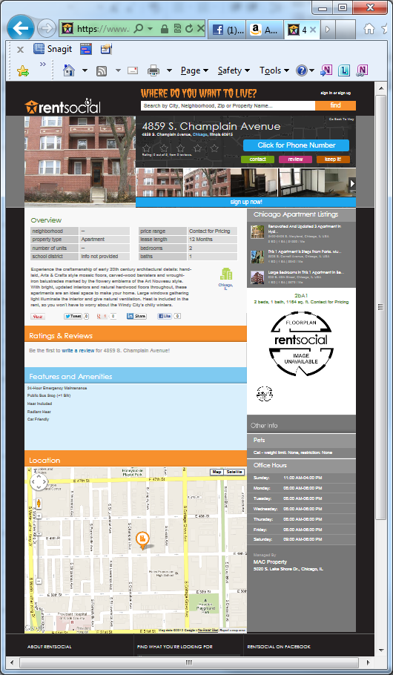
Our current external property page attempts to entice new members mostly with content and only a little with options
Content
options

Slide 2
The proposed design radically shifts this ratio. It is designed to get them clicking and keep them clicking ...
Content
Content
options
options

Slide 3
The content on our current external property page enables the user to do seven basic things:
Understand the property’s physical location (red)
See what the property looks like (aqua)
Understand and price the property’s offerings (purple)
Read what others are saying about it and understand that they’ll have the opportunity to participate in that discussion (green)
Reach out to the Property’s management company (orange)
To understand that the property can be saved to a keeper (blue)
To become a RentSocial member (black)

Slide 4
But does so more than once and often disparate places
Understand the property’s physical location (red)
See what the property looks like (aqua)
Understand and price the property’s offerings (purple)
Read what others are saying about it and understand that they’ll have the opportunity to participate in that discussion (green)
Reach out to the Property’s management company (orange)
To understand that the property can be saved to a keeper (blue)
To become a RentSocial member (black)

Slide 5
What if we raised these subjects only once and/or in the same proximity?
Understand the property’s physical location (red)
See what the property looks like (aqua)
Understand and price the property’s offerings (purple)
Read what others are saying about it and understand that they’ll have the opportunity to participate in that discussion (green)
Reach out to the Property’s management company (orange)
To understand that the property can be saved to a keeper (blue)
To become a RentSocial member (black)

