Slide 1


Slide 2
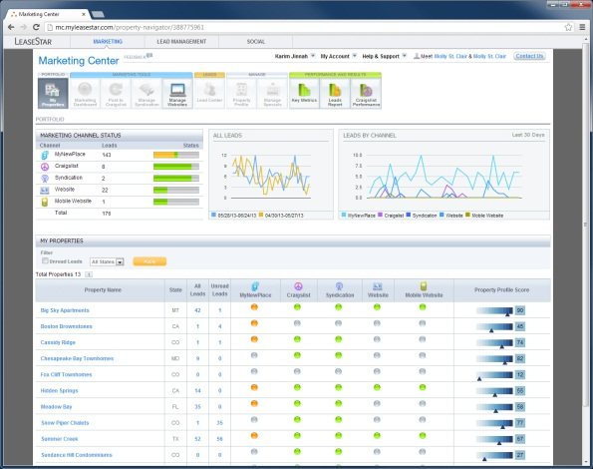
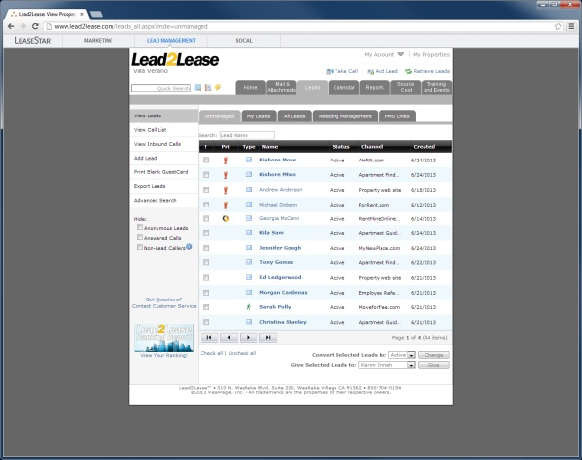
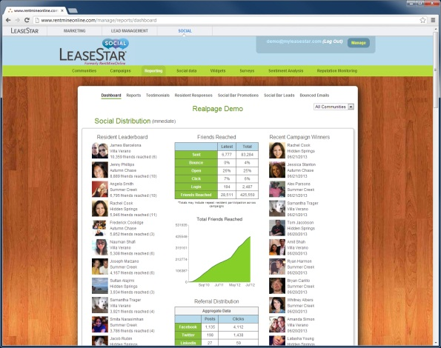
The LeaseStar Suite of Products:
Marketing Center
Lead2Lease
LeaseStar Social

Slide 3

Problem:
Marketing Center
Lead2Lease
LeaseStar Social
Investors

Slide 4
Problem:
These apps don’t look like a “suite”
Marketing Center
Lead2Lease
LeaseStar Social
Investors

Slide 5
Problem:
They don’t go together
These apps don’t look like a “suite”
Marketing Center
Lead2Lease
LeaseStar Social
Investors

Slide 6
Problem:
They don’t go together
They look like three separate products
These apps don’t look like a “suite”
Marketing Center
Lead2Lease
LeaseStar Social
Investors

Slide 7
Problem:
They don’t go together
They look like three separate products
LeaseStar is a weak brand
These apps don’t look like a “suite”
Marketing Center
Lead2Lease
LeaseStar Social
Investors

Slide 8
Problem:
They don’t go together
They look like three separate products
LeaseStar is a weak brand
These apps don’t look like a “suite”
Why would we invest further in this?
Marketing Center
Lead2Lease
LeaseStar Social
Investors

Slide 9
Solution: Unified UI
Marketing Center
Lead2Lease
LeaseStar Social
Investors

Slide 10
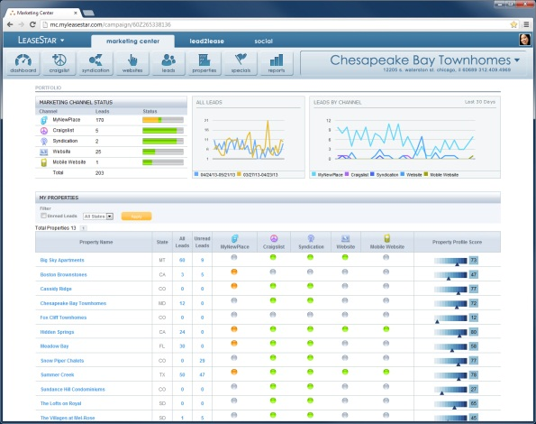
Solution: Unified UI
Marketing Center
Lead2Lease
LeaseStar Social
Investors

Slide 11
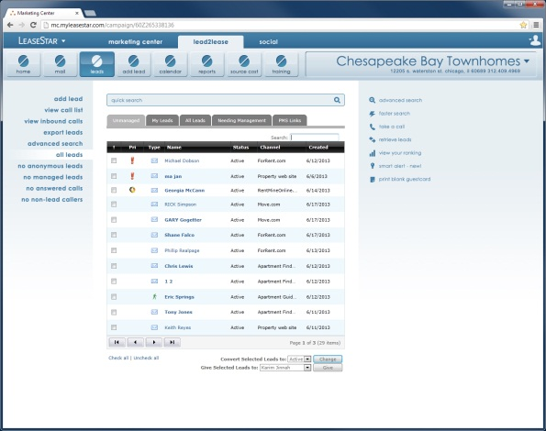
Solution: Unified UI
Marketing Center
Lead2Lease
LeaseStar Social
Investors

Slide 12
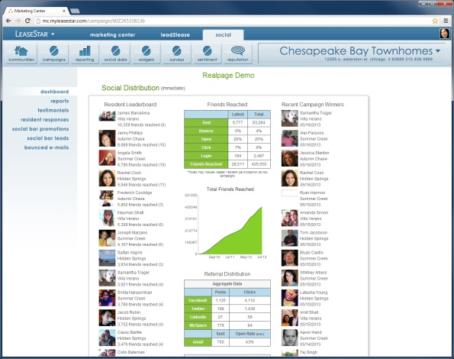
Solution: Unified UI
Marketing Center
Lead2Lease
LeaseStar Social
Investors

Slide 13

Solution: Unified UI
YES!
Marketing Center
Lead2Lease
LeaseStar Social
Investors

Slide 14


Compare:
Marketing Center

Slide 15

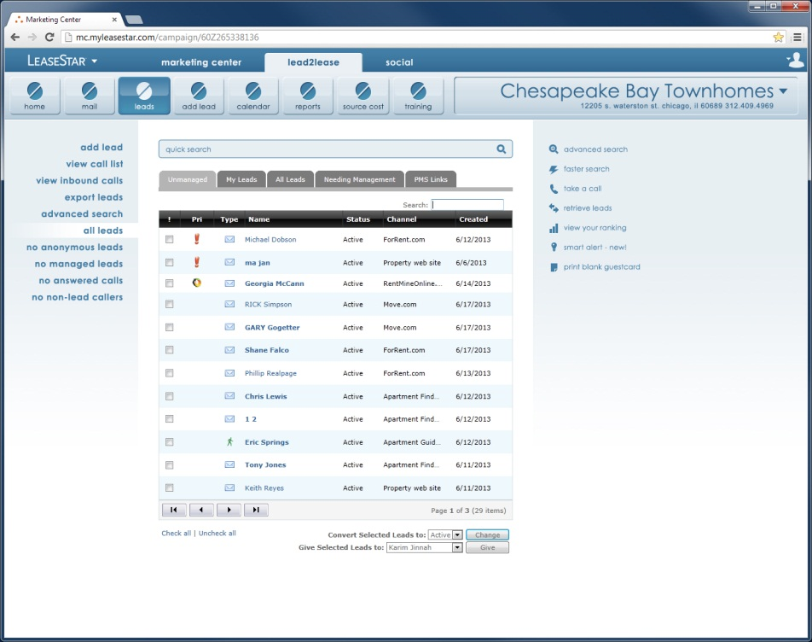
Compare:
Lead2Lease

Slide 16

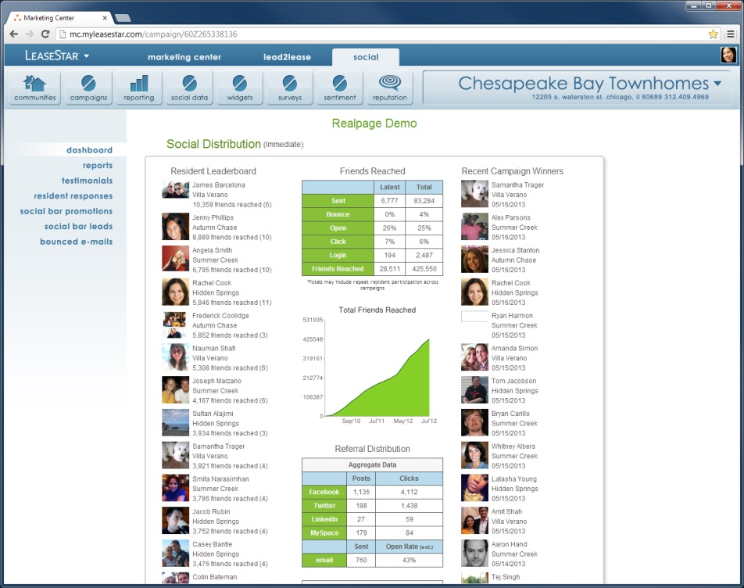
Compare:
LeaseStar Social (formerly RentMineOnline)

Slide 17
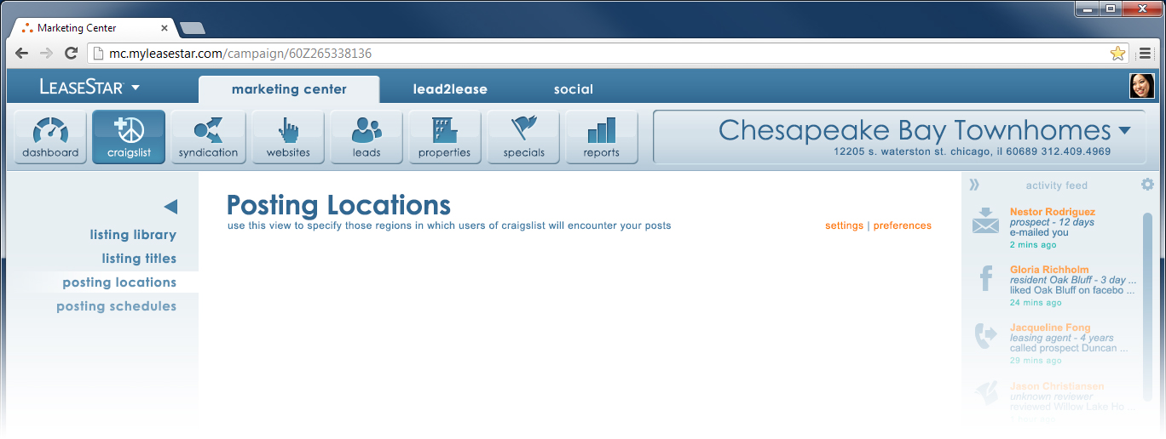
Unified Top-Level Nav:

Slide 18
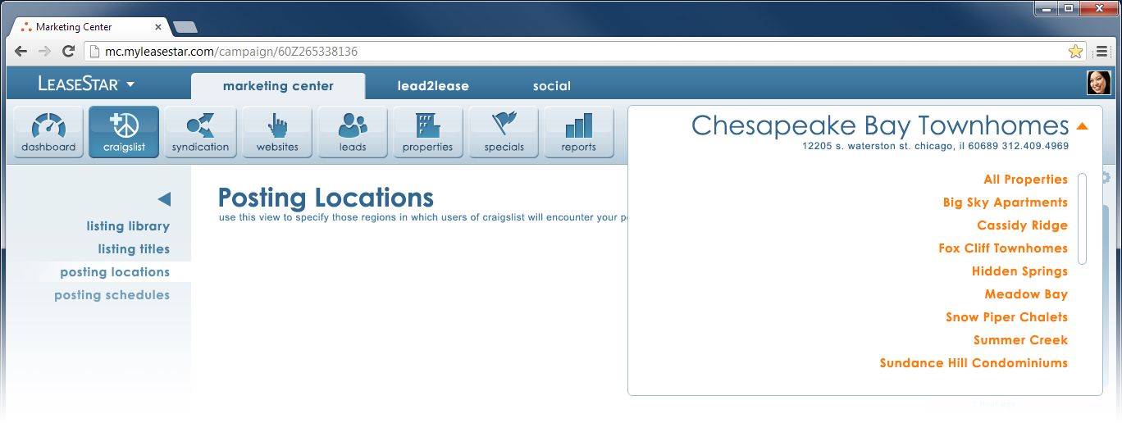
Integrated and Universal Property Selection:

Slide 19
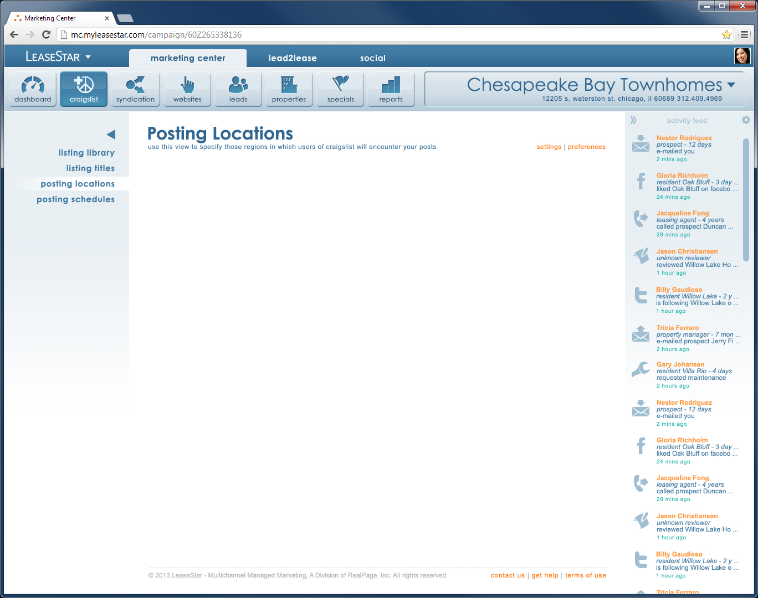
This is just the beginning!

Slide 20
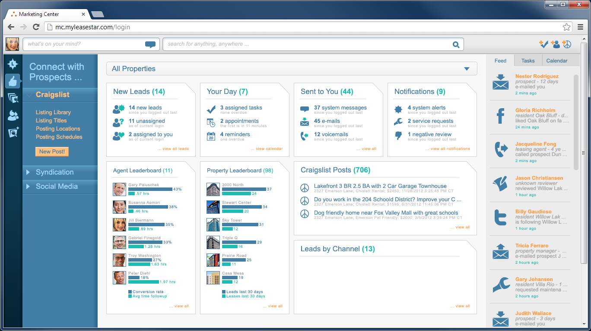

Slide 21


